Slide 1
FITNESS BEGINS WITH WHAT YOU EAT !
Project Presentation
IT414 - Group23
FORK & PENCIL
YOUR ONE STOP DAY-TO-DAY GUIDE
PROF : JAYPRAKASH LALCHANDANI
TA : KALGI GANDHI
https://github.com/DhanviShah/Fork-Pencil

Slide 2
Table of
CONTENTS
TEAM MEMBERS
3
PROJECT BACKGROUND
4
BUSINESS RULES & DESIGN AND IMPLEMENTATION CONSTRAINTS
5
USE CASE DIAGRAM
6
ACTIVITY DIAGRAM
7
TIMELINE
8
RISKS ASSOCIATED AND MITIGATION STRATEGIES
9
SYSTEM ARCHITECTURE MODEL
10
TECHNOLOGIES
11
FUTURE ENHANCEMENTS
12
IMPLEMENTATION
13

Slide 3



TEAM MEMBERS
201801165
201801167
201801168
DIVYA
VAZIRANI
DHANVI
SHAH
PARAM
MODI
Project Leader
Developer
Developer

Slide 4
PROJECT BACKGROUND
Fork & Pencil is a food website which provides nutritional information and recipes that helps people maintain better food eating habits and monitor a balanced energy level
PURPOSE OF THE PROJECT
SCOPE OF THE PROJECT
People avoid their health these days by eating staples like junk foods, eating food items having low nutrition and high calories, etc.
During the pandemic, many people were away from their places, restaurants were closed, etc., which led to a search for new recipes and the ingredients needed to prepare the food.
Check Nutritional Values of various food items
Search Recipes along with ingredients needed for various food items
Add or upload new recipe and/or nutritional values for various food items
People who want to maintain their diet and learn the new and healthy recipes of various food items with their nutritional values will use the system.

Slide 5
BUSINESS RULES
The software should contain information about nutritional values from verified sources only.
The boundaries of the software should be clearly defined and the users should be allowed to upload the content with controlled access.
DESIGN AND IMPLEMENTATION CONSTRAINTS
Implementation of login system was not done due to time constraint.
Due to budget restrictions, free API had to be used which allows only 10,000 searches.
Due to time and knowledge constraints, feature that could work as a nutritional calculator was not implemented.

Slide 6
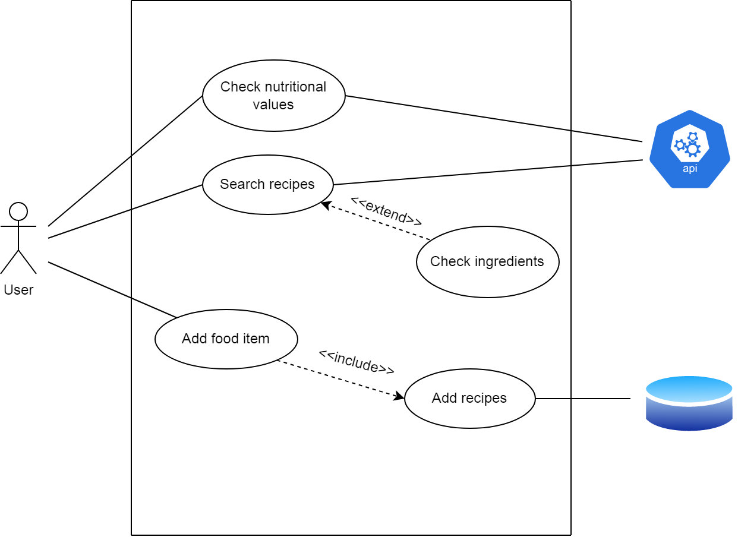
USE CASE DIAGRAM

Slide 7
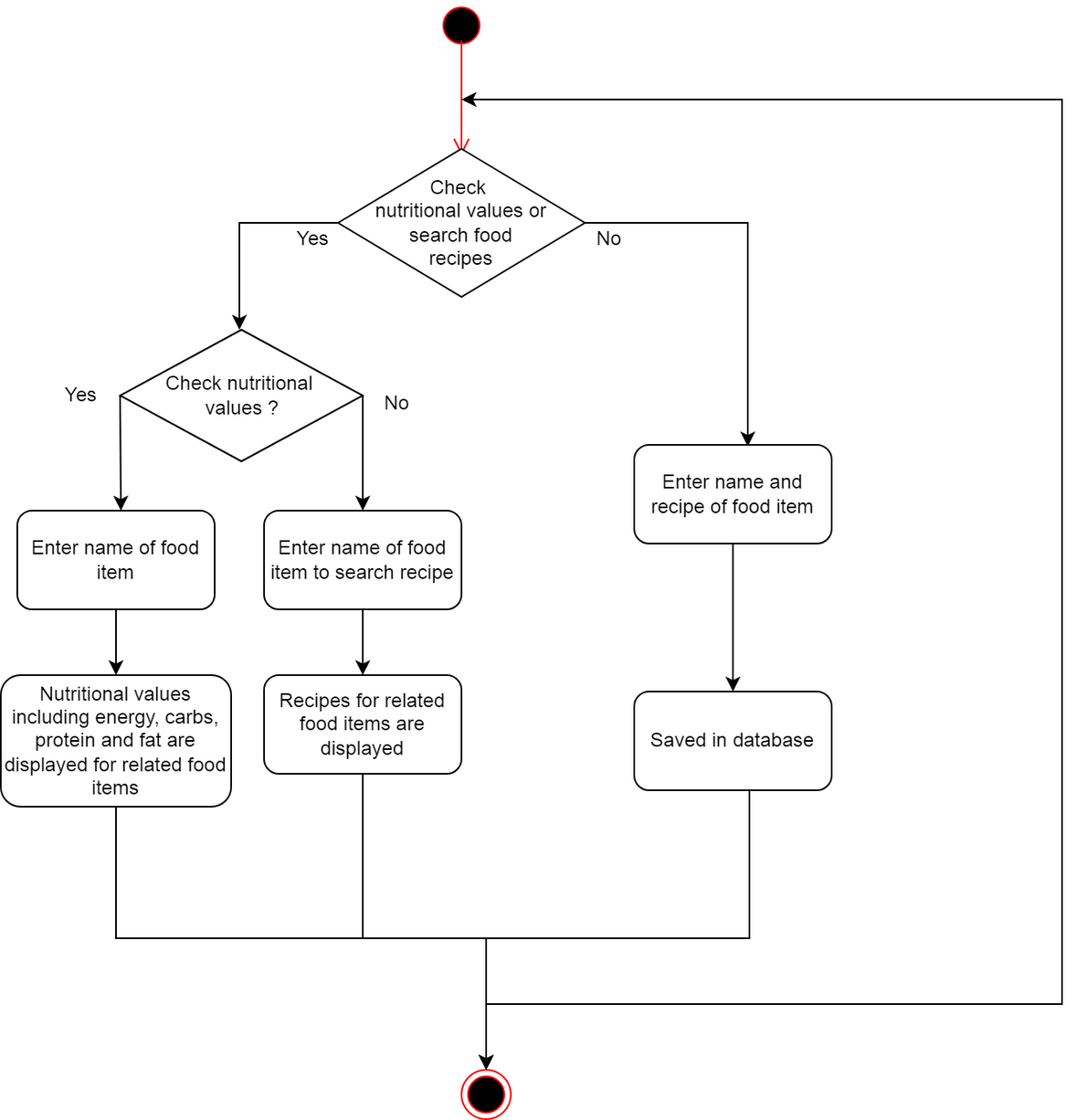
ACTIVITY DIAGRAM

Slide 8
Project
TIMELINE
OCTOBER
NOVEMBER
DECEMBER
W1
W2
W3
W4
W1
W2
W3
W4
W1
W2
W3
W4
PLANNING
REQUIREMENTS
GATHERING
TASKS &
MILESTONES
DESIGNING
DEVELOPMENT
FRONTEND FEATURE
IMPLEMENTATION
FEATURES &
PAGES INTERGRATION
BACKEND INTEGRATION

Slide 9
RISKS ASSOCIATED & MITIGATION STRATEGIES
API might fail.
Mitigation : A paid and more stable API can be used.
Due to heavy traffic of users on the website, it may crash.
Mitigation : Keep the website software updated.
Mitigation : Make continual backups and use professional server and we-hosting services.
Users might enter unwanted data in place of recipes.
Mitigation : Create a Login System which filters the unwanted people and keeps only genuine people interacting with the platform.

Slide 10
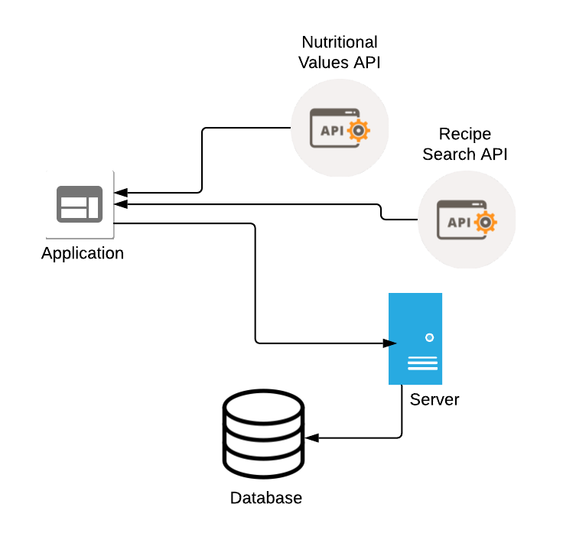
SYSTEM ARCHITECTURE MODEL

Slide 11
TECHNOLOGIES
Front-End Technologies :
React Framework
CSS
Javascript
Back-End Technologies :
Javascript
Nutritional values API (Edamam's API)
Recipe Search API (Edamam's API)

Slide 12
FUTURE ENHANCEMENTS
Implement a login system in our website for entering new recipe for a food item which would restrict the unwanted users from uploading unwanted data to the website.
Use a more stable and paid version of API which can allow unlimited searches.
Add features like sharing and commenting on food recipes on our website for users to share their opinions.
Add feature which would output the total nutritional values of searches done in one day or one week just like nutritional calculator.

Slide 13
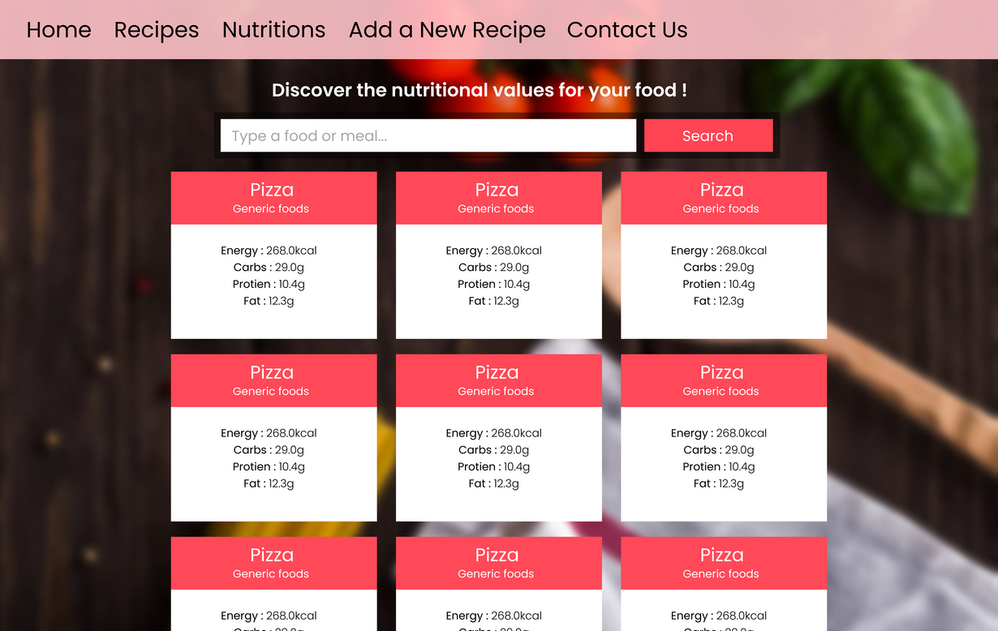
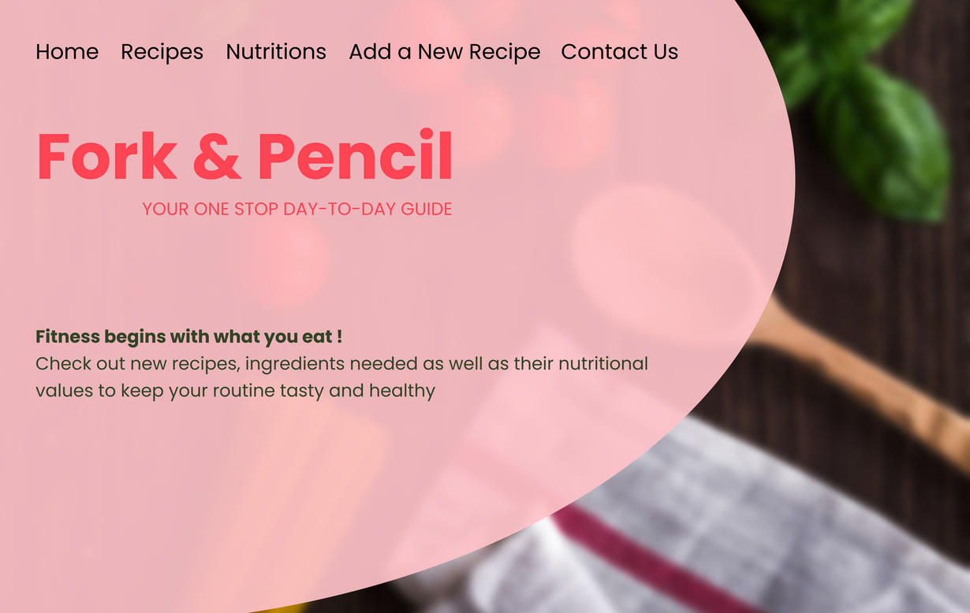
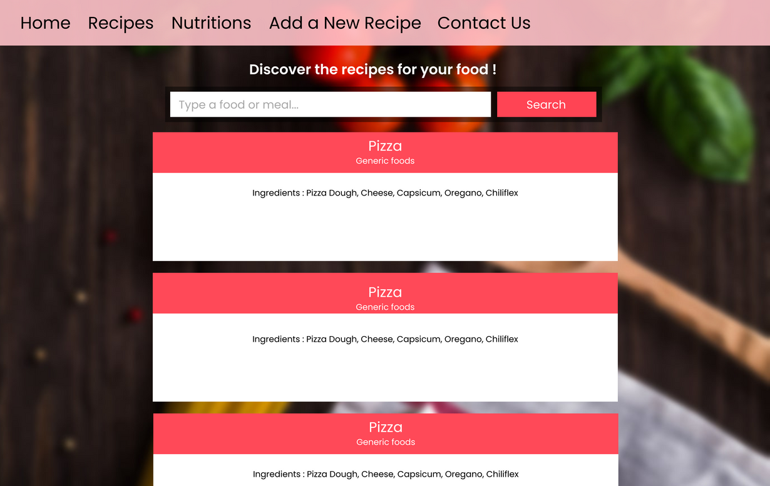
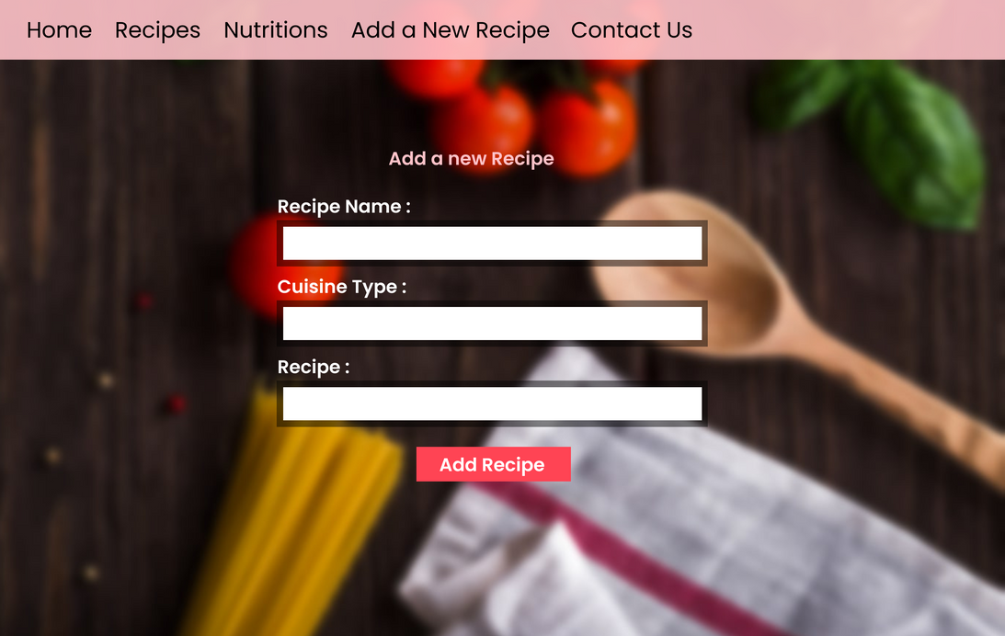
WHAT'S NEXT ??
Check nutritional values
Check recipes
FORK & PENCIL
Home Page
Add new recipe

Slide 14
THANK YOU

